Slide 1
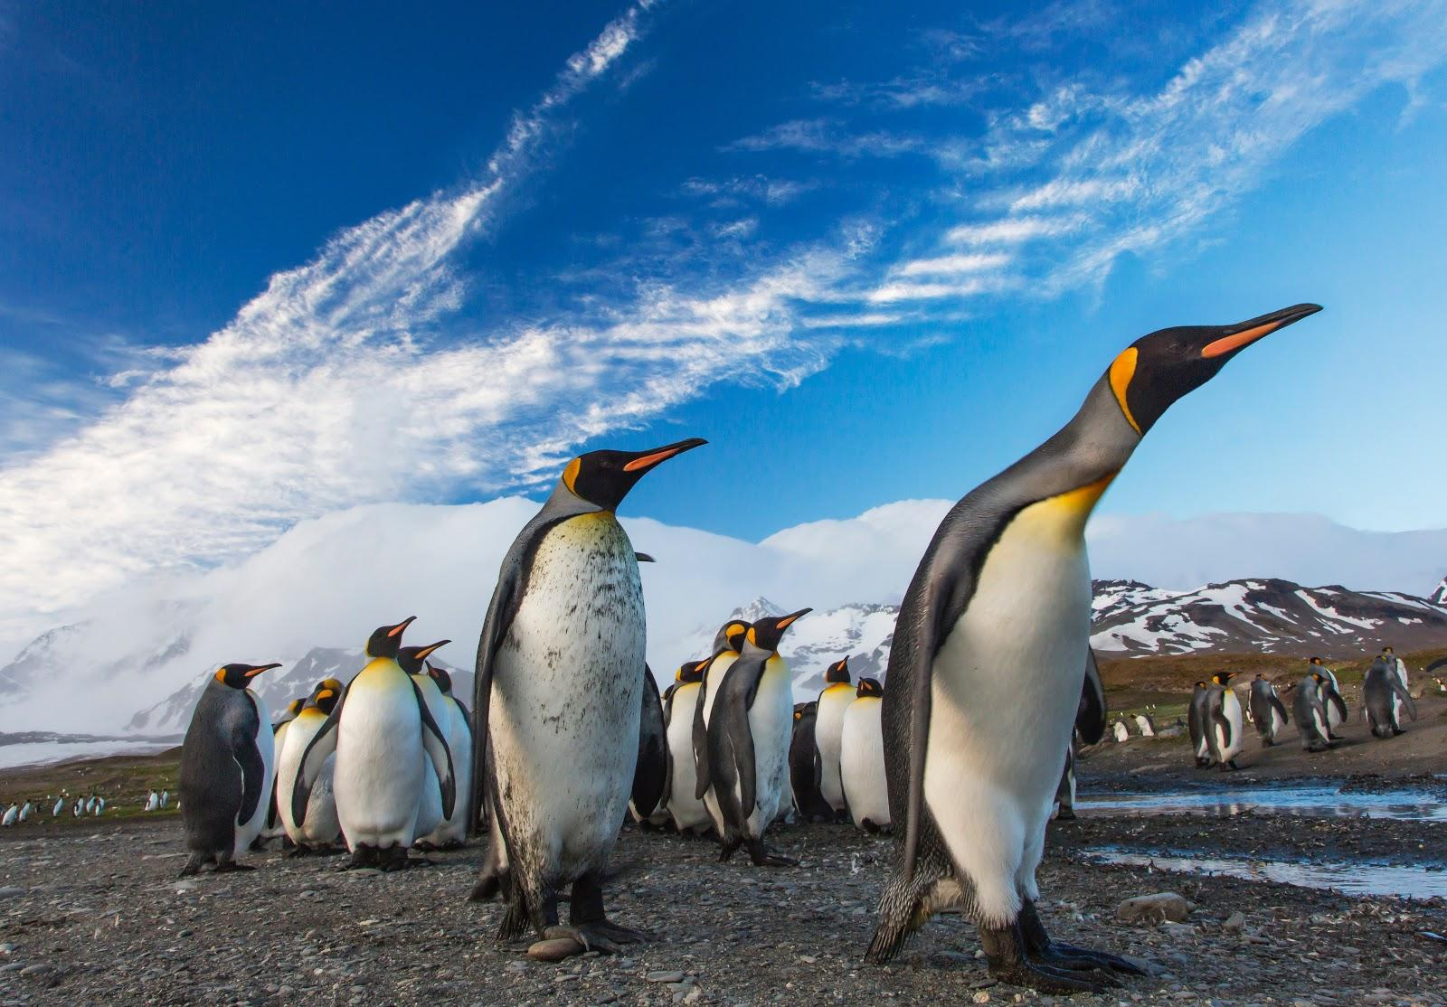
Emperor Penguins
Notes:
Ask the class if they know anything about Emperor penguins. Elicit that they are the biggest.
Photo by Ian Parker on Unsplash

Slide 2
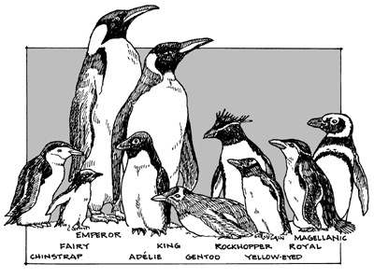
How big are Emperor penguins?
Emperors are very big birds.
They are the biggest, tallest & heaviest penguins.
Height: 120 cm tall
Weight: 22 - 45 kilos
5th heaviest bird species
Males are heavier
Tall man next to an Emperor penguin
Notes:
See here for child/emperor penguin size comparison

Slide 3
What do they look like?
white bellies
long flat wings

Slide 4
yellow patches around ears & throat

Slide 5
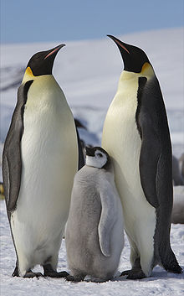
How to recognise an emperor
black feathers
pale yellow breasts
Notes:
Perhaps the easiest way to recognise an emperor is by his size

Slide 6
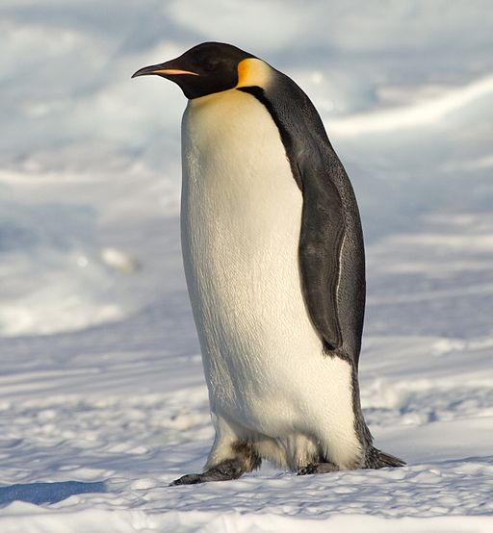
Emperor penguins have small bills.
bill/beak
Notes:
It helps keep them warm - like insulation in a house. They also take small breaths.
photo © Samuel Blanc [CC-BY-SA-3.0 (http://creativecommons.org/licenses/by-sa/3.0)], via Wikimedia Commons

Slide 7
Their wings are like flippers
wing
Penguins use wings for swimming
Notes:
The flippers are for swimming & walking on ice
Photo © Samuel Blanc [CC-BY-SA-3.0 (http://creativecommons.org/licenses/by-sa/3.0)], via Wikimedia Commons

Slide 8
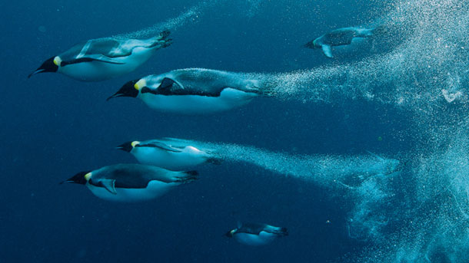
Emperor penguins are excellent swimmers
They use their wings like flippers
There bodies are the right shape
They can swim underwater for 20 minutes
Notes:
At sea, emperor penguins glide through the water with great speed and agility. Their aerodynamic bodies and strong flippers make them excellent swimmers, reaching speeds of 3.4 m/s (7.6 mph). They can dive deeper than any other bird – as deep as 565 m (1850 ft.) – and they can stay under for more than 20 minutes.
Photo Paul Nicklen, National Geographic

Slide 9
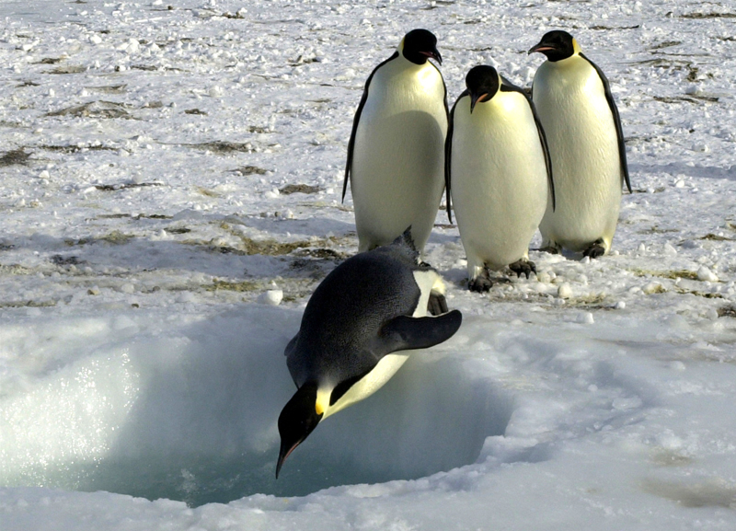
Emperor penguins are great divers
An Emperor dives into the sea through a hole in the ice.
They can dive 565 metres under the water.
Notes:
They can dive deeper than any other bird – as deep as 565 m (1850 ft.) To compare point out that the he Empire State Building is only 450 metres high
Photo courtesy of National Science Foundation

Slide 10
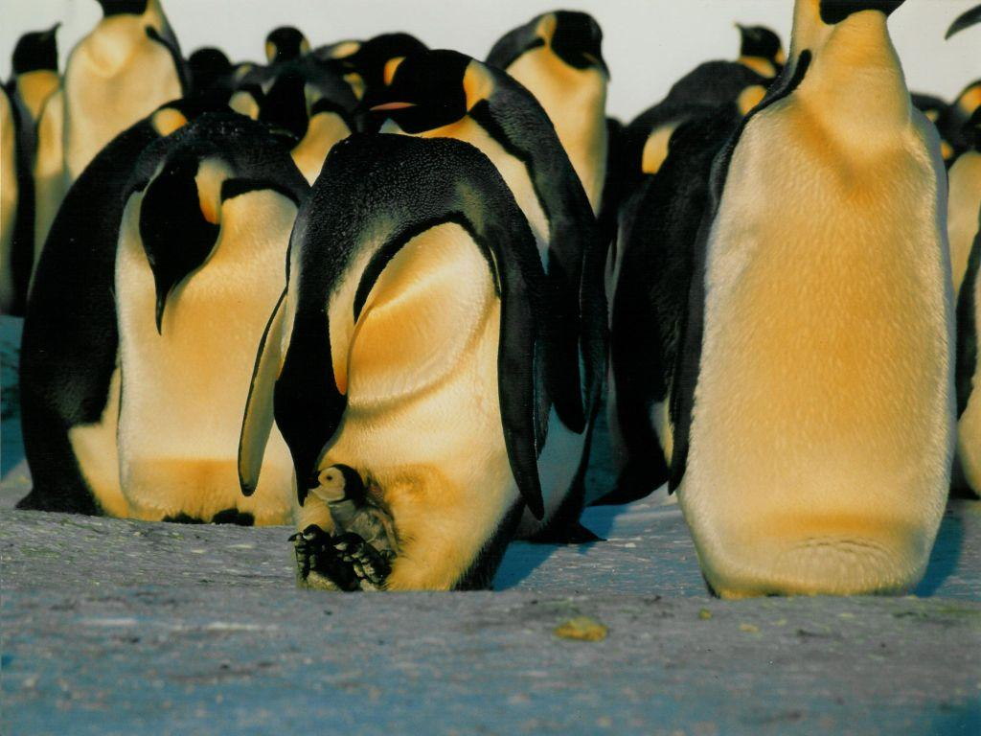
How do Emperor chicks stay warm on the ice?
Mothers keep their chicks warm in their brood pouches.
Notes:
Point out that cold is still a great danger. If a chick falls on the ice it will probably die in a few minutes

Slide 11
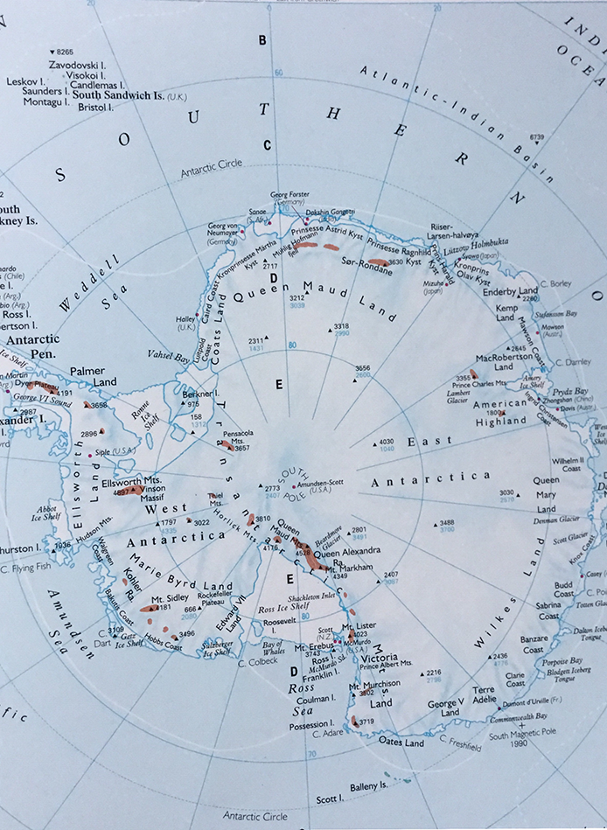
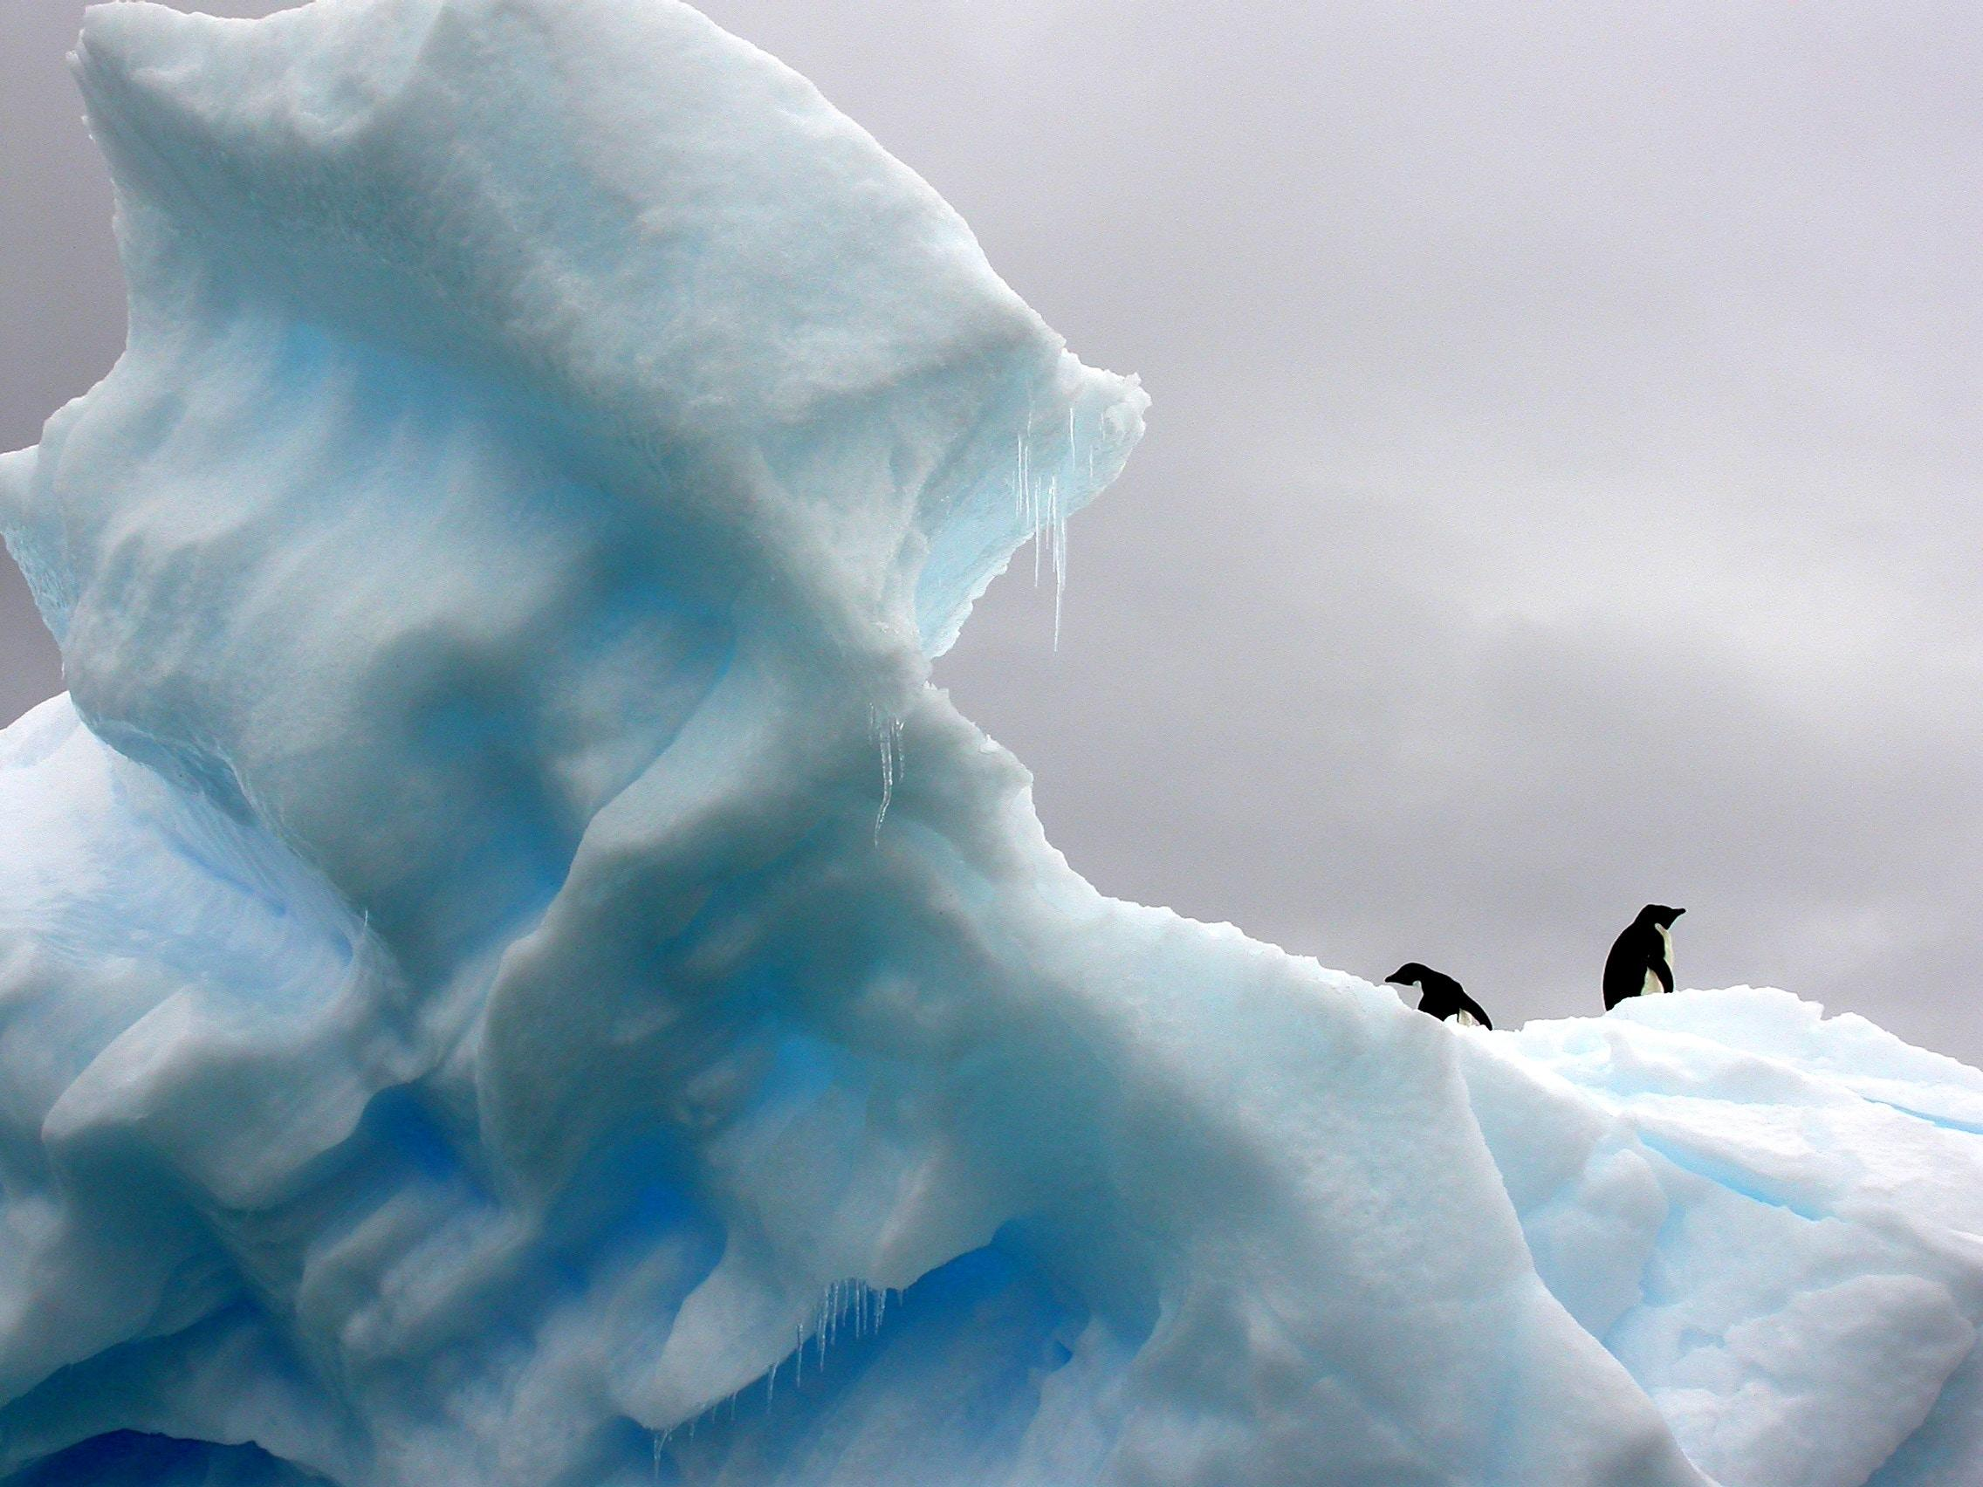
Habitat
Emperor penguins live on the ice in Antarctica.
Antarctica is the coldest
place in the world
Notes:
Antarctica - point out that it is very big and very cold!
In winter it is dark 24 hours a day
Penguins are the only animal or bird to live in Antarctica

Slide 12
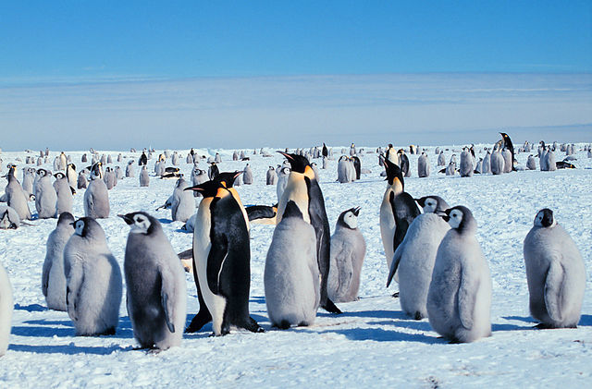
How do they keep warm?
Emperor huddle together to keep warm!
They also take turns to stand out of the wind!
Notes:
Antarctica - point out that it is very big and very cold!
In winter it is dark 24 hours a day
Penguins are the only animal or bird to live in Antarctica

Slide 13
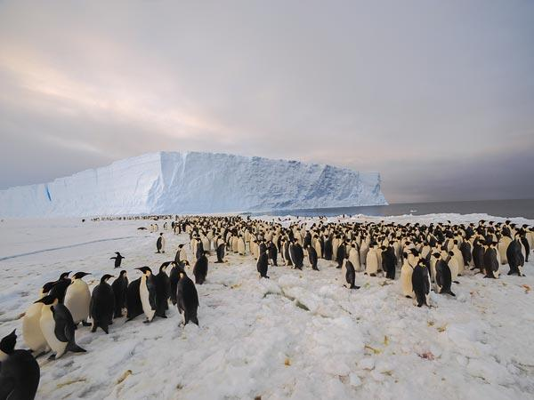
Colonies
Antarctic penguin colony of 9,000 penguins. Most are chicks -
Notes:
Colonies - explain that a colony is like a big family. Penguins don't like to be alone.
In winter it is dark 24 hours a day
Penguins are the only animal or bird to live in Antarctica
Photograph of Atlantic Penguin colony courtesy International Polar Foundation

Slide 14
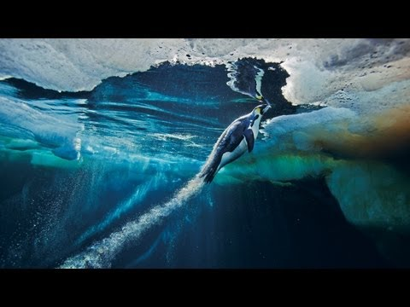
Emperor Penguins Underwater
Watch how they come out from under the ice

Slide 15
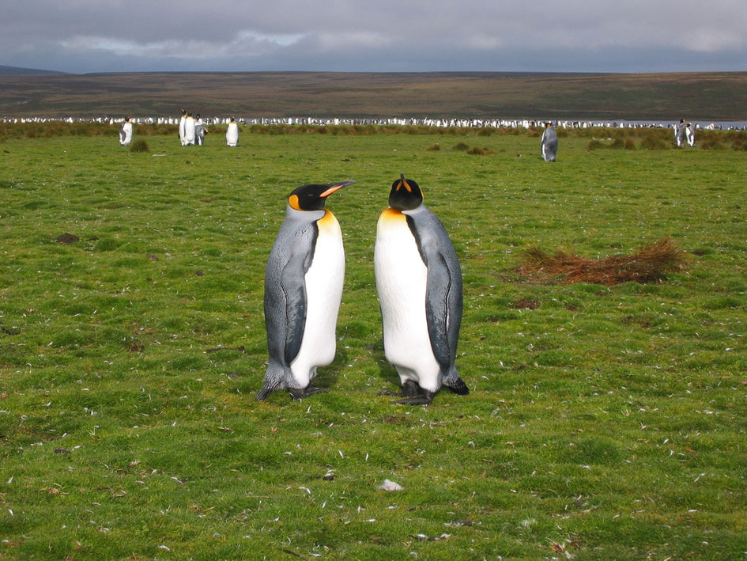
Find more penguininformation
Fun Facts About Penguins
Fun Penguin Facts Adelie * Rockhopper * Little * African
Notes:
Penguin Teaching Materials

